Slide 1

DSN2099
PROJECT EXHIBITION-II
Final Review

Slide 2

Introduction – group - 06
“Software Approach To Enigma Machine”
Guided By- Dr.Raja Soundaran
Reviewer- Dr.Saravanan.D

Slide 3


Team Members :-
M.Pon Dinesh Kumar
20MEI10010
Yogesh Panchal
20MEI10026
Sourabh Sahu
20MEI10033
Debroop Sarkar
20MEI10078

Slide 4

Introduction
An Enigma machine is a electro mechanical rotor cipher machines used for the encryption and decryption of secret massages.
computing history, and have a deep look into the mechanEnigma Machine has played an important role in the history of computing, from motivating the development of the first electronic computer to enabling secure Web-based communication and commerce. This program enable us to know the role of encryption in military and ism of Enigma machine.
The needs of data protection.
Using computers, the Allies were eventually able to break the Enigma code, giving them an intelligence edge that changed the balance of the war.
Enigma Machine has played an important role in the history of computing, from motivating the development of the first electronic computer to enabling secure Web-based communication and commerce. This program enable us to know the role of encryption in military and computing history, and have a deep look into the mechanism of Enigma machine.
The needs of data protection.
Enigma Machine has played an important role in the history of computing, from motivating the development of the first electronic computer to enabling secure Web-based communication and commerce. This program enable us to know the role of encryption in military and computing history, and have a deep look into the mechanism of Enigma machine.
The needs of data protection.
Enigma Machine has played an important role in the history of computing, from motivating the development of the first electronic computer to enabling secure Web-based communication and commerce. This program enable us to know the role of encryption in military and computing history, and have a deep look into the mechanism of Enigma machine.
The needs of data protection.

Slide 5
PROPOSED WORK AND METHODOLOGY
We want to write a program to simulate the Enigma machine to decrypt the secret code produced by the Enigma machine.
And also we try to write a program to decrypt the secret code produced by Enigma machine.
Rotating Ciphers
After each letter is encoded, the key is rotated so that the first character is moved to the end.
Example: a b cdef→ hjasdb
Method:- Data encryption and decryption Encryption is the process of translating plain text data (plaintext) into something that appears to be random and meaningless (ciphertext). Decryption is the process of converting ciphertext back to plaintext.To encrypt more than a small amount of data, symmetric encryption is used.

Slide 6
HARDWARE & SOFTWARE REQUIREMENT
HARDWARE REQUIREMENTS
SOFTWARE REQUIRERMENTS
One PC
Processor – Min Core i3
RAM – Min 4GB
SSD – 256GB/128GB
System Bus:- Either 32-Bit or 64-Bit
Keyboard:- Windows compatible
Processing 4 software
Operating Environment :-
Windows XP/Vista/7/8,
Mac, OSX, Linux

Slide 7
Literature Review :-
The goal of every encryption algorithm is to make it as difficult as possible to decrypt the generated ciphertext without using the key. If a really good encryption algorithm is used, then there's no technique significantly better than methodically trying every possible key. For such an algorithm, the longer the key, the more difficult it is to decrypt a piece of ciphertext without possessing the key.It's difficult to determine the quality of an encryption algorithm. Algorithms that look promising sometimes turn out to be very easy to break, given the proper attack. When selecting an encryption algorithm, it's a good idea to choose one that's been in use for several years, and has successfully resisted all attacks.For more information, see Data encryption and decryption functions.

Slide 8
Module & explanation
Enigma:- meaning hard to understand or explain
The Enigma was influential in the field of cipher machine design, spinning off other rotor machines.
Enigma SIM:- Enigma simulator, the message procedures as used by the German Armed Forces, including some authentic message.
Light :- For each letter pressed, one lamp lit indicating a different letter according to a pseudo-random substitution determined by the electrical pathways inside the machine.
Plugpoint :- The Enigma machine had several cables with a plug at each end that could be used to plug pairs of letters together.
Rotor :- The rotors (alternatively wheels or drums, Walzen in German) form the heart of an Enigma machine. Each rotor is a disc approximately 10 cm (3.9 in) in diameter made from Ebonite or Bakelite with 26 brass, spring-loaded, electrical contact pins arranged in a circle on one face, with the other face housing 26 corresponding electrical contacts in the form of circular plates. The pins and contacts represent the alphabet — typically the 26 letters A–Z, as will be assumed for the rest of this description.

Slide 9


NOVELTY OF THE PROJECT
In this Project :-
Firstly we have implement our code and run.
Then apply Substitution cipher and execute properly
Then open the Enigma machine Interface run the program succesfully .
Implement our system Architecture Diagram.

Slide 10
Operate Enigma machine
Flow Diagram :-
Give the Command Normal Text
Give the Command encrypt message
Read a character
Processing
Yes
Check and Rotate
Return a Character
Decrypted Message

Slide 11
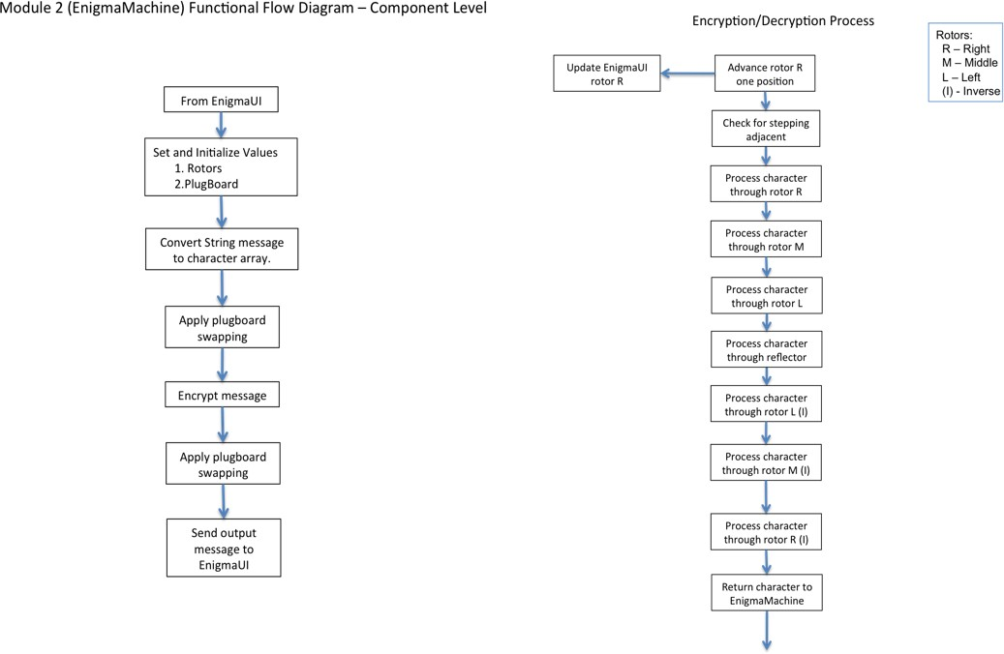

Overall System Architecture Diagram :-
Encryption/decryption Process
Update EnigmaUI rotor R
Advance rotor R one position
Process character through reflector
Check for stepping adjacment
Proceess character through rotor L(|)
Proceess character through rotor R
Processing
Proceess character through rotor M(|)
Proceess character through rotor M
Proceess character through rotor R(|)
Proceess character through rotor L
Return character to Enigma machine

Slide 12
Algorithm
The Enigma machine implemented a substitution cipher, which encrypts a message by substituting one character for another. Such ciphers go back at least as far as Julius Caesar, who used a simple substitution cipher to encrypt military orders.
By rotating the rotor we obtain a new substitution cipher. As an example, suppose the rotor used to produce the substitutions is given by the following values in the first position:
ABCDEFGHIJKLMNOPQRSTUVWXYZ TMKGOYDSIPELUAVCRJWXZNHBQF.
To encrypt the first letter we use the substitutions given above; i.e. we substitute B by M and Y by Q. However, to encrypt the second letter we rotate the rotor by one position, i.e. we move the bottom row one step to the left, and so use the substitutions
ABCDEFGHIJKLMNOPQRSTUVWXYZ MKGOYDSIPELUAVCRJWXZNHBQFT,

Slide 13
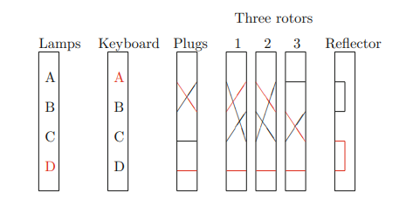
whilst for the third letter we use the substitutions
ABCDEFGHIJKLMNOPQRSTUVWXYZ KGOYDSIPELUAVCRJWXZNHBQFTM
Figure :- Simplified Enigma Machine

Slide 14
REAL TIME USAGE
In this technological world it will protect information using Encrypt and Decrypt method.
This is also use for our military base where they can use software approach method and communicate with each other.

Slide 15

EXISTING WORK WITH LIMITATION
The Enigma machine was considered so secure that it was used to encipher the most top-secret messages.
Enigma code was that a letter could never be encoded as itself.
(Modern computers would be able to crack the code in several minutes)

Slide 16
After completion the presentation we will present our code and Execute successfully then Show The live demo of our project.

Slide 17
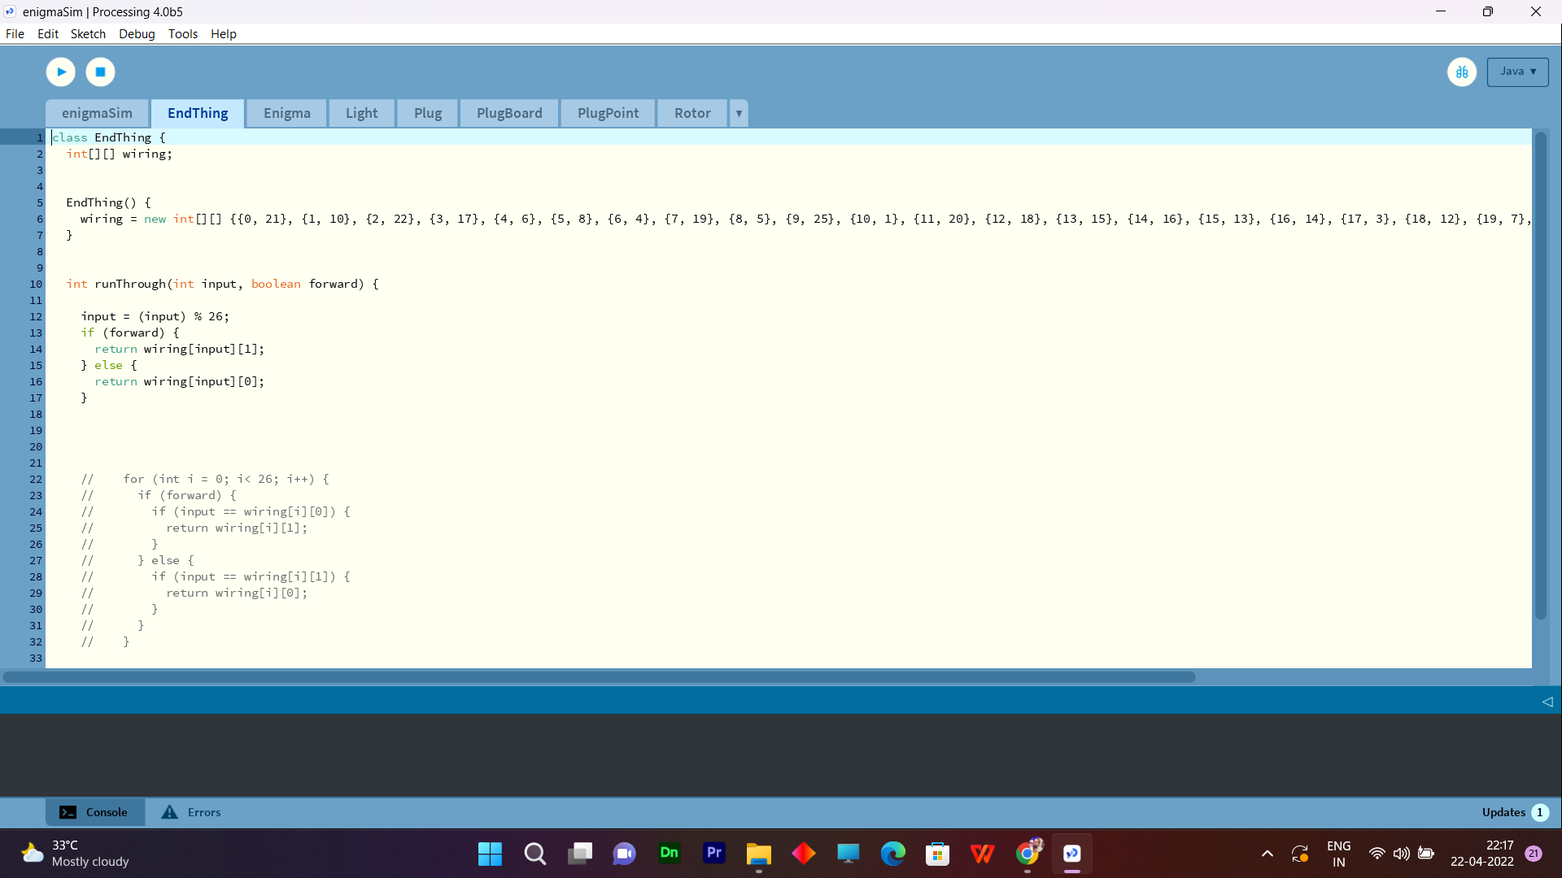
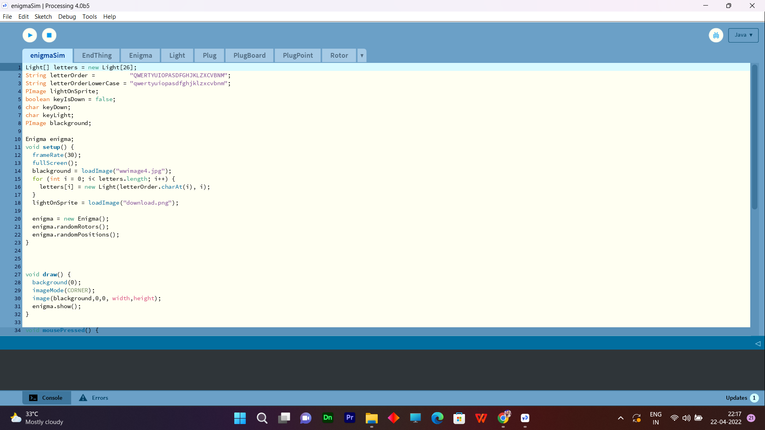
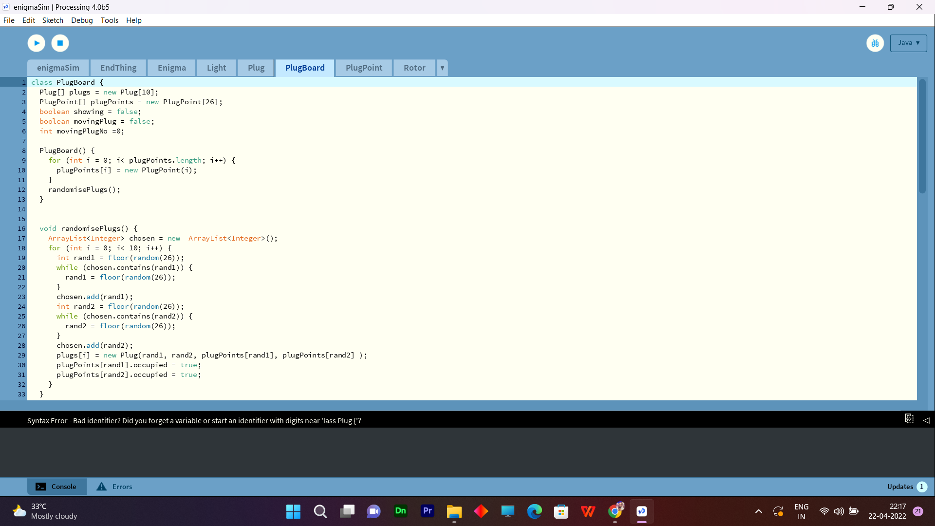
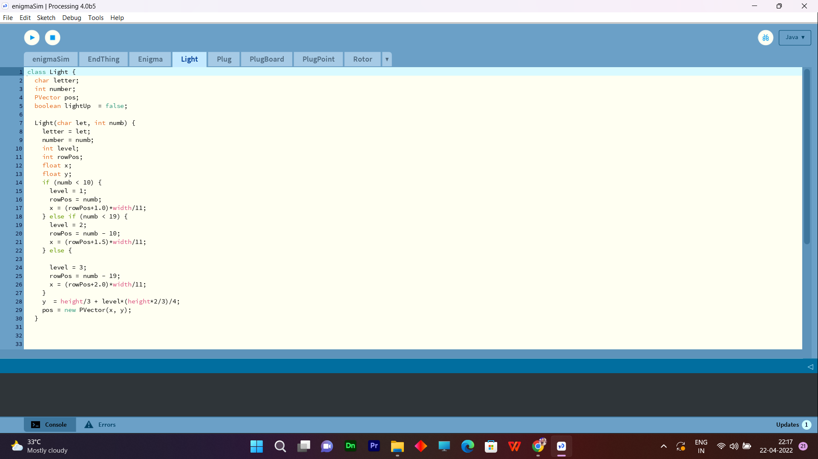
Snapshot Of Our Project:-

Slide 18
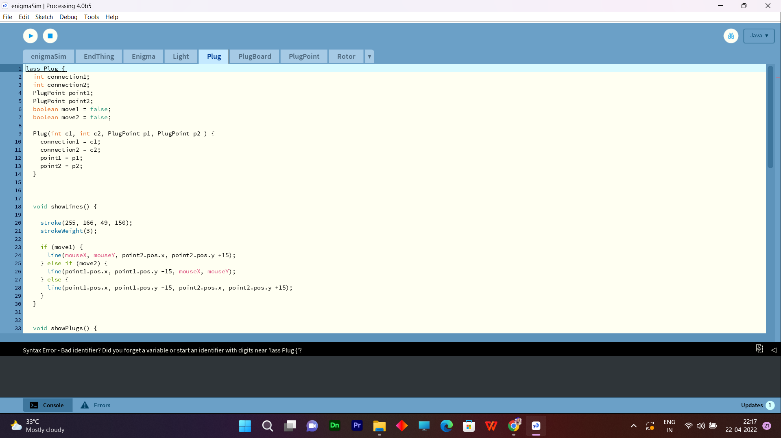
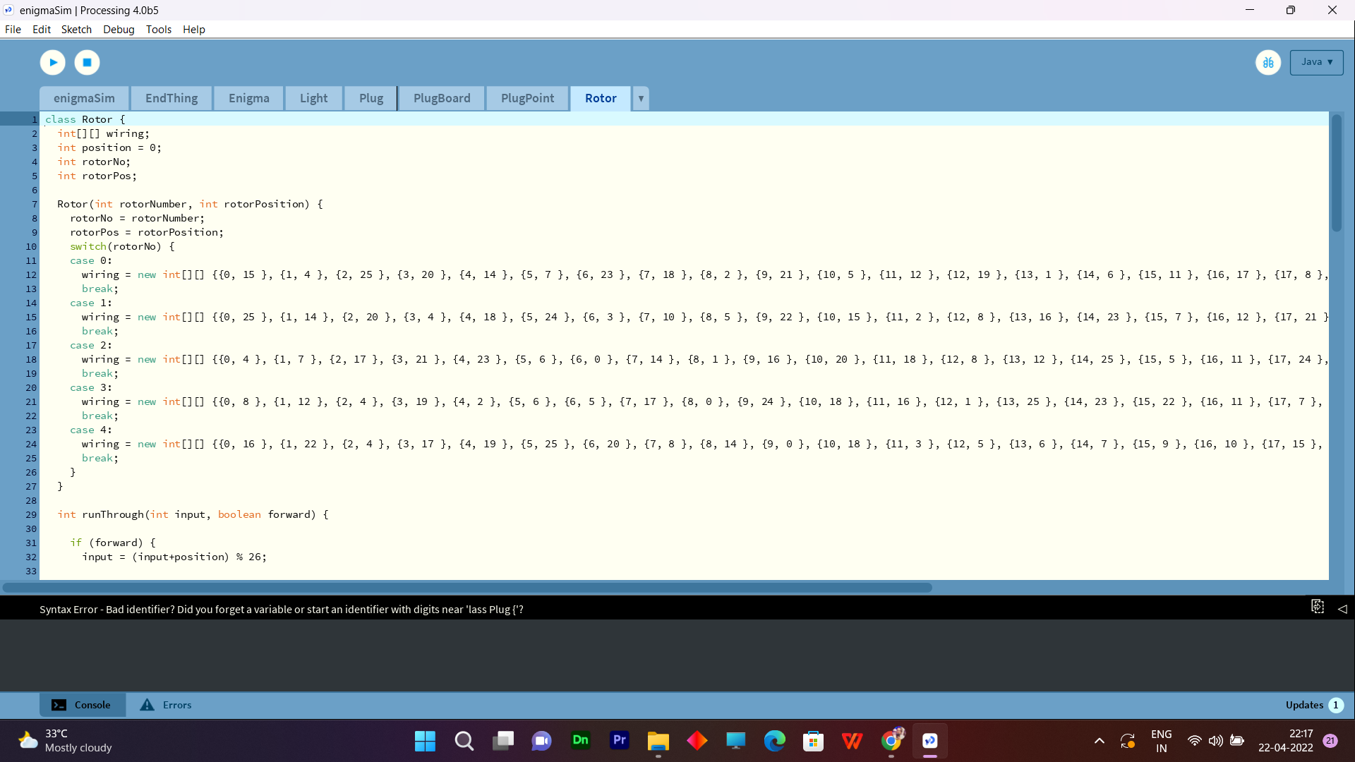
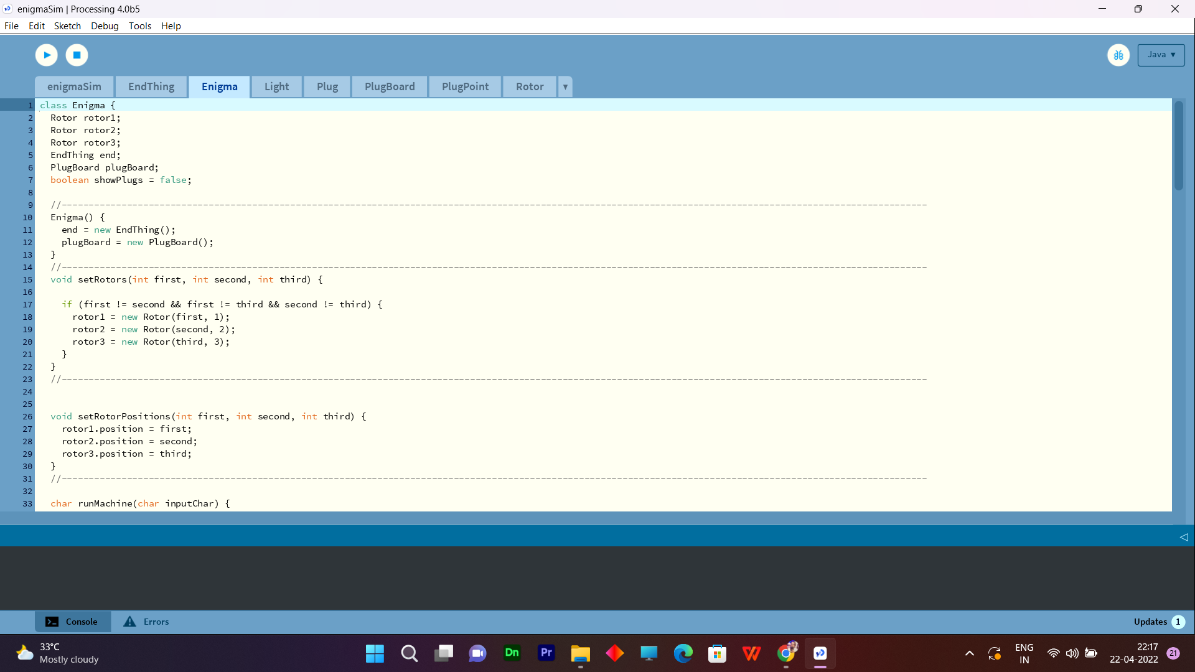
Snapshot Of Our Project:-

Slide 19
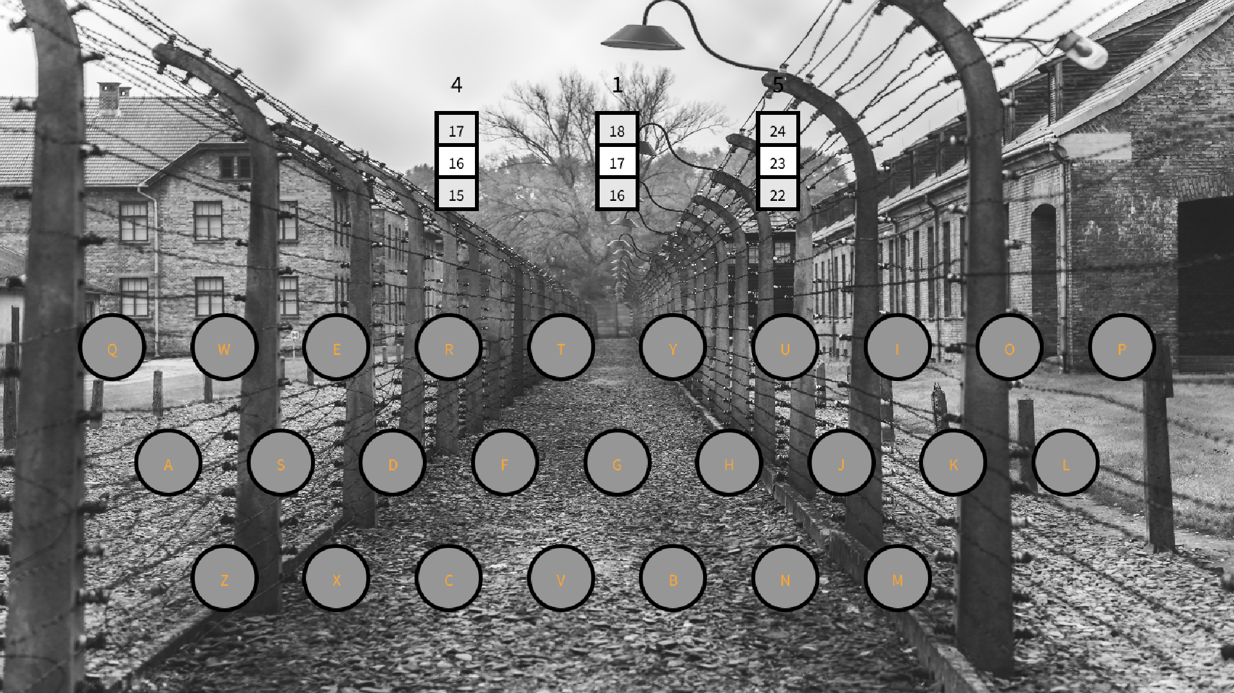
Snapshot Of Our Project :-
This Interface based on GUI ( Graphiclal User Interface) Using App Development
After Run The Code you got this type interface

Slide 20
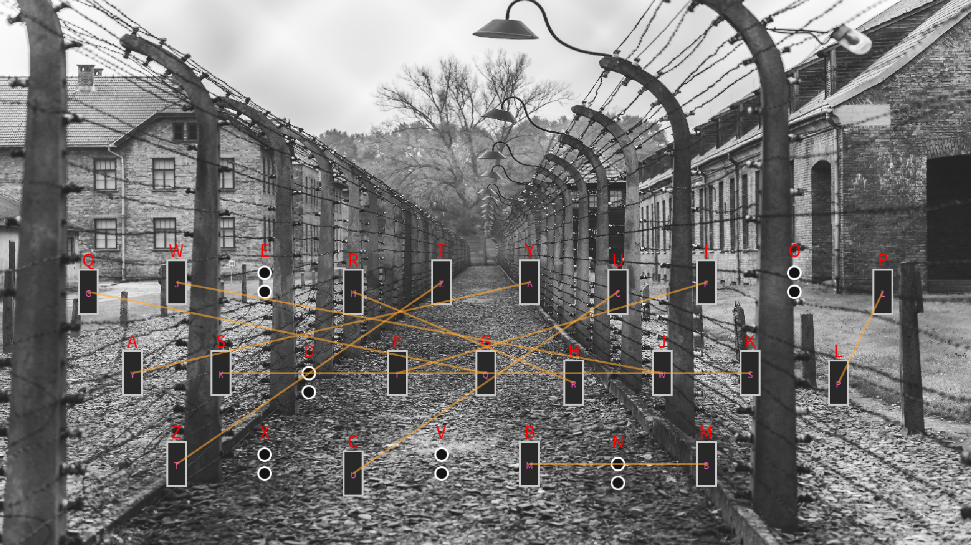
Snapshot Of Our Project :-
This Interface based on GUI ( Graphiclal User Interface)
After Run The Code you got this type interface, And these are the connection of inside the software Enigma machine.

Slide 21
Testing :-
Supose for testing purpoe we will take here one test.
Normal Text Message:- VIT BHOPAL
Rotor Position :- 1-5-2
Rotor Dial No. :- 12-1-5
Connection :- Q-B E-M T-P U-P I-D
O-J X-L S-L G-V C-N
Encrypted Message :- SJJQSXXVB
Now, Again set the same rotor position because after enter the Normal message rotor dial position will change so we need to set the same rotor dial position and Enter the Encrypted Message.
Decrypted Message:- VIT BHOPAL

Slide 22
Discussion
In future this project may be .
In World War II where the Enigma Machine was used for communication .
Similer this project use in future like for gaming .
If we developed this project a large structure then it will be sufficient for more secure the information.
And it is very reliable for our military base where they can use software approach method and communicate with each others.

Slide 23
Result
In Software Approach To Enigma Machine produce a good Result
Which is very clear and clarifying that
When we are trying to encrypt or decrypt the any messages using substitution techniques or encryption and decryption method.
That is easly encrypt or decrypt the messages without any error.
This project is very capable to secure the information .
And as you know the Enigma machine is used in world war II so it also use to for our military base where they can use software approach method and communicate with each other.
In Software Approach To Enigma Machine produce a good Result
Which is very clear and clarifying that
When we are trying to encrypt or decrypt the any messages using substitution techniques or encryption and decryption method.
That is easly encrypt or decrypt the messages without any error.
This project is very capable to secure the information .
And as you know the Enigma machine is used in world war II so it also use to for our military base where they can use software approach method and communicate with each other.

Slide 24
Conclusion:-
The Enigma was a very save ciphering machine at its time. Because its heavy usage, the operators of the army made errors which allowed the first breaking.
In this technological world it will protect information using incrypt and decrypt method.
And it is very reliable for our military base where they can use software approach method and communicate with each others.

Slide 25
Refrences :-
https://www.mpoweruk.com/enigma.htm
CONTRIBUTORS, W. Enigma machine — Wikipedia, the free encyclopedia, 2020. [Online; accessed 24-January-2020].
https://www.researchgate.net/publication/314935733_The_Enigma_Machine.
https://www.researchgate.net/figure/Schematic-diagram-of-Enigma-machine-from-Scheribus-1928_fig3_273320579
Wikipedia, “Enigma Machine”, http://en.wikipedia.org/wiki/Enigma_machine

Slide 26

THANKS!

